Slide 1

An Examination of the Relationship of Yellowstone Wolf and Elk Populations from 1995 to 2022
Data Analytics and Visualization Fair
Student: Shannon Keeney
Professor: Dr. Rafael Perez Pena

Slide 2
Outline
Introduction
Graph 1
Graph 2
Conclusion

Slide 3
Introduction
  Wolves were extirpated in Yellowstone National Park in 1926
  Herbivore species, like elk, lost a natural predator
  Without wolves, elk would eventually reach their carrying capacity in the ecosystem
  Wolves reintroduced in 1995 and 1996
  The purpose of this project is to visually examine the relationship between the Yellowstone wolf population and the elk population

Slide 4
Graph 1
Graph 1 shows the average wolf count and the predicted elk count, the left y-axis is for the wolf count, and the right y-axis is for the predicted elk count. The populations stabilize in 2009.
Cassidy et al., 2024
Yellowstone National Park

Slide 5
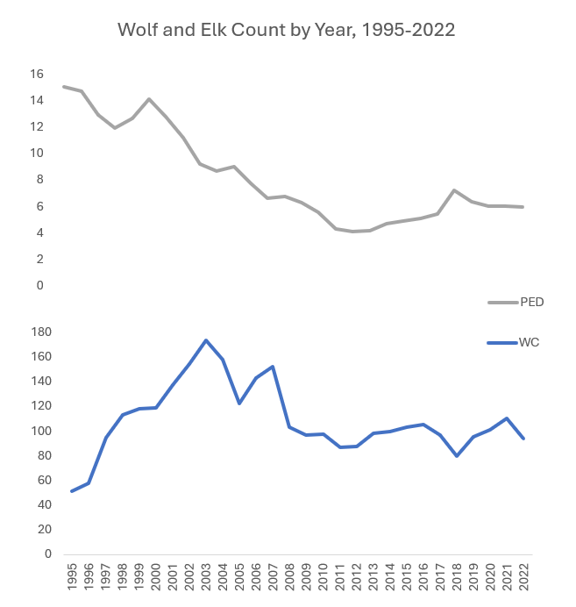
Graph 2
Graph 2 shows the average wolf count and the predicted elk count from 1995 to 2022 on two graphs with the same x-axis and 2 y-axis.
Cassidy et al., 2024
Yellowstone National Park

Slide 6
Conclusion
  After Yellowstone wolves were reintroduced, the elk population has been on a downward trend.
  It also shows that after small spikes in the elk population that there is also a small spike in the wolf population. Which then is followed by a small decrease in both populations.
  Both populations leveled out in 2009 and have had small fluctuations since then.
  This project visually analyzed the population trends; further analysis is needed to confirm these insights

